Slide 1
AI Survey Results
Amanda Rohrer
Notes:
JobHistory table released in October, opportunity to answer some of the questions that have been lingering. What kind of coverage is there? Does the time series align with other sources? How far would I trust this data?
Two approaches – top level and detailed industry comparison

Slide 2
Questions
Does your state/department have a formal policy about the use of Generative AI tools and applications such as ChatGPT, Claude, or Copilot?
Do you use Generative AI tools or applications for work?
Would you be interested in connecting with other LMI offices about this topic?

Slide 3
Who responded?
19 responses, representing 15 states
Alabama | 1
Illinois | 1
Iowa | 1
Maine | 1
Minnesota | 1
Nebraska | 1
Nevada | 1
North Carolina | 1
Ohio | 2
Oregon | 1
South Carolina | 2
Texas | 3
Virginia | 1
Washington | 1
Wisconsin | 1
Notes:
Decline in IT jobs is consistent with news reports and out of line with trends in other occupations
Persistent hiring difficulties in Health Care is consistent with news reports
Excessive IT representation is pulling the total down
NEXT QUESTION: To weight them in a way that gives a more coherent total, we need to know what the coverage looks like

Slide 4
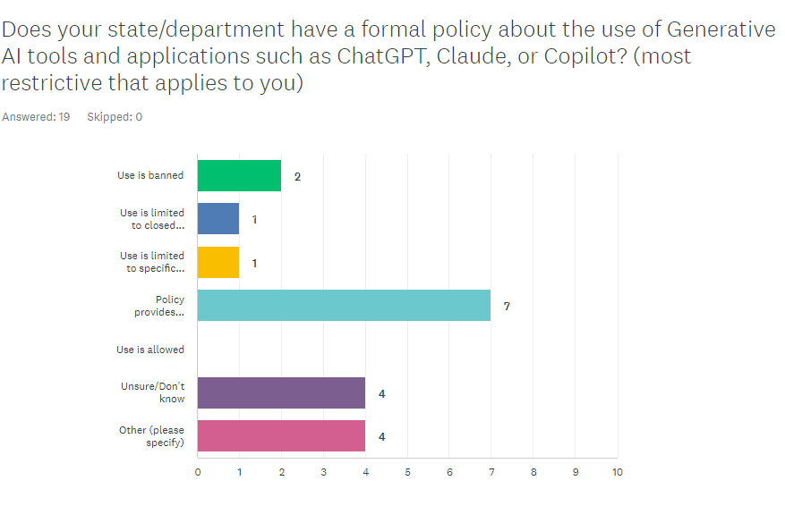
Policies
Use is allowed, but a formal policy is still in the process of being created.
Policy exists but is not very clear. Currently being rewritten
Bill passed in the General Assembly but policy has not been implemented yet.
No formal policy in place.

Slide 5
Models in Use
None yet
ChatGPT 4 Microsoft CoPilot Claude Google
ChatGPT-4, Claude 2
none
ChatGPT, Claude, Copilot, Gemini, Perplexity
We're model agnostic at this point because the market is too immature and fast moving.
ChatGPT, CoPilot
ChatGPT
ChatGPT, Google Vertex AI
None
Open AI GPT 3.5
Chat GPT, Copilot

Slide 6
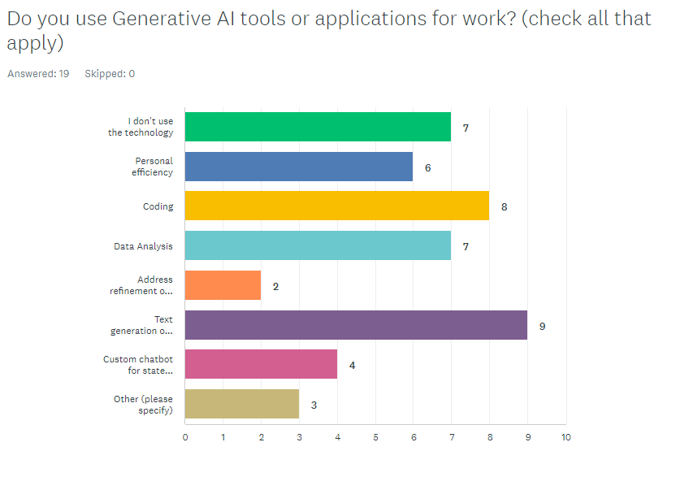
Current Use
Integration with LMI and workforce related web applications
I am developing a ChatGPT interface for the WID API
Summarizing text

Slide 7
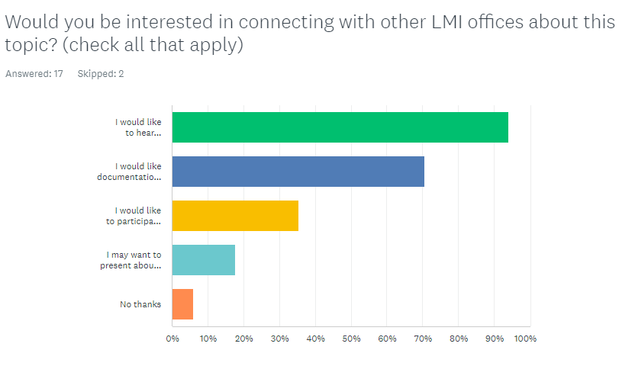
Future Engagement
Notes:
JOLTS encompasses all of educational services, not just schools (2/3)
Jobhistory series starts a bit late, but initial increase is consistent with JOLTS, if a little delayed
Seasonal increase in the summer months of QUITS and LAYOFFS, Jobhistory reflects that pattern
Continuing increase in 2023 could be a local variation (anecdotal evidence of staffing shortages)

Slide 8
Other Comments
Our agency does encourage the use of the innovative technology, but there are limitations due to confidential personal information.
Would be interested to know the use of AI at a granular level of how other teams are using for efficiency, accuracy and overall.
Maine Information Technology has established a moratorium on the adoption and use of Generative AI for all State of Maine business and on any device connected to the State of Maine network. I am interested in hearing how these technologies are being used in other states though have no use cases from our state as a result of the moratorium.
We are behind a firewall with another state agency in charge of IT. I'm sure this will come to us, but not sure when.
Really interested in hearing about the details for secure sandbox models that can work with PII to look for trends in intersecting administrative data including workforce system participants, UI claims, and job ads.
Before too many states create too many different generative AI products it would be very useful for a national group to establish some kind of consistency & guidelines. The more that states can leverage work done by others so that activities are consistent, the better.

